Slide 1
Depression in Older Adults
A RAFT Presentation

Slide 2
Statistics About Depression and Older Adults
An estimated 7 million of the nation’s 39 million adults aged 65 years and older are affected by depression, but only 10% receive treatment.
Depression is not recognized and is often undertreated in the older adult

Slide 3
Many older adults who die by suicide (up to 75%) suffer with depression and most visited a physician within a month before death.
Depression is NOT a part of normal aging

Slide 4
“I didn’t know anything about depression so I didn’t know I was depressed.”~ IMPACT participant

Slide 5
Older Adult’s Attitudes Toward Depression
According to a Mental Health America survey on attitudes and beliefs about clinical depression:
Approximately 68% of adults aged 65 and over know little or almost nothing about depression.
Only 38% of adults aged 65 and over believe that depression is a “health” problem.
If suffering from depression, older adults are more likely than any other group to “handle it themselves.” Only 42% would seek help from a health professional.
About 58% of people aged 65 and older believe that it is “normal” for people to get depressed as they grow older.

Slide 6
What does depression look like in older adults?
Many older adults and their families don’t recognize the symptoms of depression, aren’t aware that it is a medical illness.
A key feature of depression in later life is often it’s present with a physical health condition-- e.g., with physical illness such as stroke, diabetes, cognitive disorder

Slide 7
Depression in older persons is characterized by:
memory problems
confusion
social withdrawal
loss of appetite
weight loss
vague complaints of pain
inability to sleep
irritability
delusions (fixed false beliefs)
hallucinations

Slide 8
Causes of Depression
Certain medicines or combination of medicines
Physical disability and other illness
Living alone, social isolation
Recent bereavement
Presence of chronic or severe pain
Damage to body image (from amputation, cancer surgery, or heart attack)
Fear of death
Lower income and increased financial burdens
Past history of depression and suicidal attempts
Family history of major depressive disorder

Slide 9
Depression looks different in older adults
Higher levels of psychological motor retardation, agitation, weight loss, lack of activity
Tendency to talk more about bodily symptoms instead of depression
Loss of interest is more common

Slide 10
Depression looks different in older adults (cont.)
Social withdrawal is more common
Irritability is more common
Less depressed mood
more on fatigue, sleep and appetite changes, vague GI complaints, memory or concentration problems, anxiety

Slide 11
Is it grief or depression?
As people age, they experience many losses. Loss is painful—whether it’s a loss of independence, mobility, health, your long-time career, or someone you love. Grieving over these losses is normal and healthy, even if the feelings of sadness last for a long time.

Slide 12
Treatment options
Therapy
Overcoming mental health sigma
Provides education about depression and available treatments,
Encourages engagement in some form of behavioral activation, such as engaging in physical activity or scheduling pleasant events.

Slide 13
Primary Care Doctors
More than 55% of older persons treated for mental health services received care from primary care physicians. Less than 3% aged 65 and older received treatment from mental health professionals.
Primary care physicians accurately recognize less than one half of patients with depression, resulting in potentially decreased function and increased length of hospitalization.

Slide 14
Medications

Slide 15
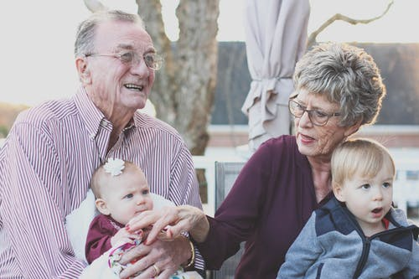
Other ways to cope
Exercise
Bright light
Connecting with family and friends

Slide 16
What happens if depression is not treated?
Suicide risks in older adults
The consequences of depression in the elderly require serious attention because of the disproportionately high risk of suicide
If the depression is so bad that it can lead to older adults not eating or drinking enough, causing them to become dangerously ill.

Slide 17
Considerations when addressing treatment with older adults
Be aware of physical limitations and utilize a team approach with treatment involving primary care doctor if necessary.
01
Respect their choice and preferences for treatment.
02
Be thoughtful and tactful with your approach
03

Slide 18
Thanks for joining us!
Please take a moment to complete our survey. We appreciate your feedback.
https://www.surveymonkey.com/r/ZB92CJP

Slide 19
References
Lawrence Robinson, Melinda Smith, M.A. and Jeanne Segal, Ph.D. (2020) Depression in Older Adults: Signs, Symptoms, Treatment
Depression in older adults https://www.rcpsych.ac.uk/mental-health/problems-disorders/depression-in-older-adults
Depression in Older Persons FACT SHEET https://www.ncoa.org/wp-content/uploads/Depression_Older_Persons_FactSheet_2009.pdf\
https://www.cdc.gov/prc/study-findings/research-briefs/program-helps-elderly.htm
Mental health America, https://www.mhanational.org/depression-older-adults-more-facts
CDC (2009). Centers for Disease Control and Prevention and National Association of Chronic Disease Directors. The state of mental health and aging in America Issue Brief 2: addressing depression in older adults: selected evidence-based programs, 2009.
https://www.apa.org/topics/aging-depression

