Slide 1
Communicating with Older Adults
A RAFT presentation
Notes:
Welcome, and thank you for joining todays training on Communicating with Older Adults.
This training today will be presented by The RAFT Team and is available on our website at RAFTNorthernVirginia.org.

Slide 2
Why is Communication Important
Communication is crucial to building and maintaining relationships because it is how we express needs, concerns, and relate to each other.
Communication is more than words it is a combination of attitude, tone of voice, facial expressions, and body language.
Notes:
Why is Communication Important
Communication is crucial to building and maintaining relationships, it is how we express our needs, concerns and relate to each other. Communication is more than words it is the combination of attitude, tone of voice, facial expressions and body language.

Slide 3
Tips on Effective Communication With Older Adults
Communicating can often be challenging with older adults.
Learning to communicate effectively with older adults can have numerous rewards.
Notes:
Communicating with older adults can often be challenging. Older adults tend to have multiple physical or mental ailments. Which includes differences in ideals and viewpoints or other issues that may make it difficult to communicate. In addition they may be faced with psychological barriers such as dementia that make it hard for them to care for themselves.
Learning to communicate effectively with older adults can have numerous rewards. Let’s explore ways we can effectively communicate with older adults.

Slide 4
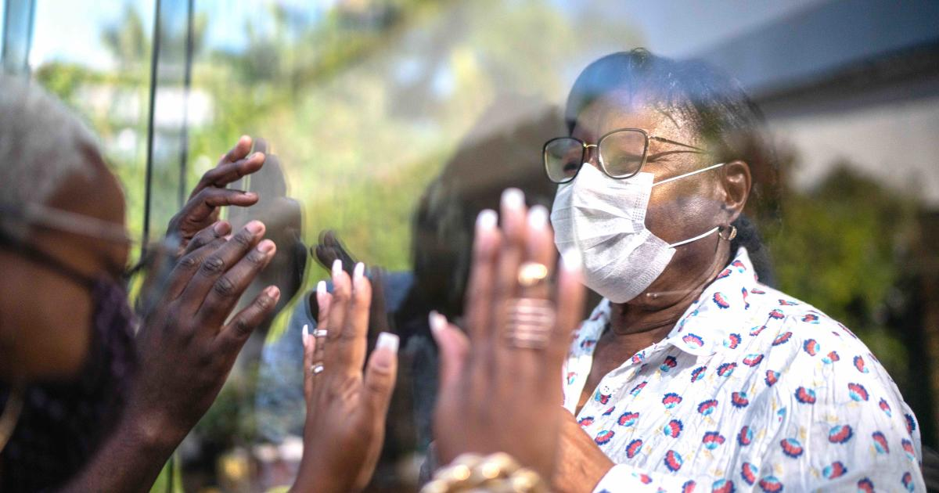
Tips on Effective Communication with Older Adults (cont.)
Face to Face
Sitting face to face can help to facilitate communication
Many older adults have visual or hearing loss and may rely upon lip-reading or facial cues to understand what you are saying. Sitting face to face also helps to eliminate visual distractions, and will give them the feeling that you think they are important.
Notes:
Tips on Effective Communication with Older Adults
When communicating with older adults sitting face to face can help to facilitate communication. Many older adults have visual or hearing loss and may rely upon lip-reading or facial cues to understand what you are saying.
Sitting face to face also helps to eliminate visual distractions and will give them the feeling that you think they are important.

Slide 5
Respect Differences
Generational gaps can create differences in opinion, views and general outlooks on life. An attitude of respect and tolerance for differing beliefs can help you to better handle communications with older adults.
Cultural differences can play an important role. Awareness of these differences can help you to avoid misunderstandings or accidental insults.
Have respect for the autonomy of the older adults don't try to do things for them that they can still do for themselves.
Allow them to maintain their dignity, while still being helpful if needed or asked.
Notes:
Respecting Differences
Generational gaps can create differences in opinion, views and general outlooks on life.
An attitude of respect and tolerance for differing beliefs can help you to better handle communications with the older adults.
1. Cultural differences can play an important role. Awareness of these differences can help you to avoid misunderstandings or accidental insults.
2. Have respect for the autonomy of the older adults ,don't try to do things for them that they can still do for themselves.
Allow them to maintain their dignity, while still being helpful if needed or asked.

Slide 6
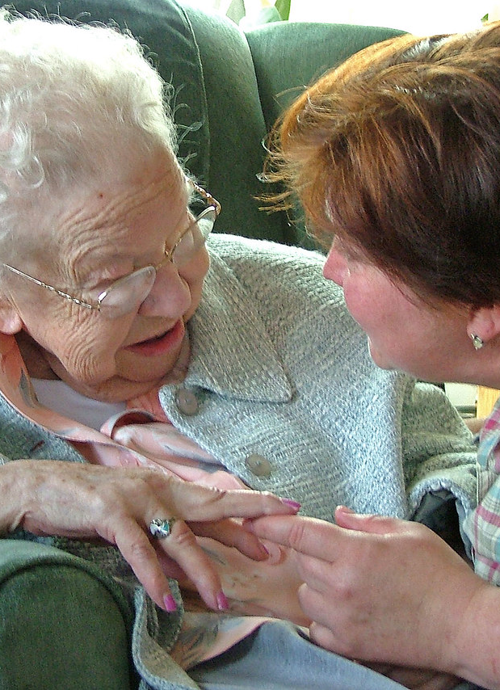
Communicate Clearly
Clear communication skills are vital when communicating with older adults
Speak clearly using an appropriate volume and rate of speech, so that the other person can understand you.
Truly listen to the person you are speaking with.
Good communication with older adults depends on good listening.
Stick to one topic at a time to avoid confusion, and try not to get irritated or frustrated if you have to repeat something several times. Try to maintain a calm and empathetic attitude.
Notes:
Communicate Clearly
Clear communication skills are vital when communicating with older adults.
It is important to speak clearly, with a appropriate volume and rate of speech. Take your time and listen carefully to who you are speaking with. Stick to one topic at a time to avoid confusion, you may have to repeat yourself several times. Try to maintain a calm and empathetic attitude.

Slide 7
Communication Barriers With Older Adults
Lack of proper communication is one of the biggest hurdles working with older adults.
Reduced communication skills are one of the results of aging, which is something that is beyond your control.
Notes:
Communication Barriers with Older Adults
Lack of proper communication is one of the biggest hurdles when caring for older adults .
*It can lead to frustrations in both the older adult and their caregiver. There are several reasons why communication becomes less effective, but most of them are due to their reduced hearing capacity or inability to express their thoughts clearly. Since communication involves a clear exchange of information involving two parties, a gap exists when one of either parties fail to function.
Reduced communication skills are one of the results of aging, which is something that is beyond your control.
*However, your ability to identify the source of the problem will consequently determine the steps you need to take in order to resolve them. Solutions can be as simple as finding alternative means to communicate outside of verbal signals, or as intricate as medical treatment.

Slide 8
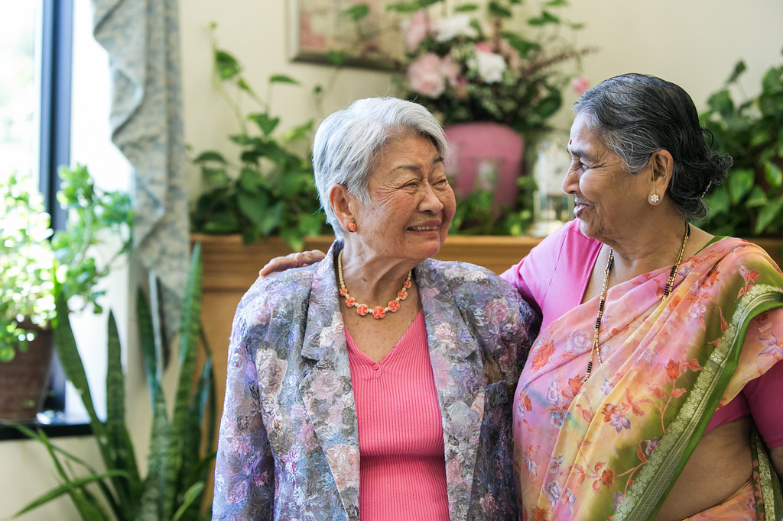
Overcoming Communication Barriers With Older Adults
There are various reasons why aging people lose their ability to communicate properly.
Failing hearing
Vision problems or failing eyesight
Effect of medications
Structural or neurological damage
This Photo by Unknown Author is licensed under CC BY-ND
Notes:
Overcoming Communication Barriers
Failing hearing – When people age, they undergo many changes with hearing . Reduced hearing capacity is a natural effect involved with the natural aging process. When an older person lacks proper hearing capacity, they do not recognize when someone is talking nor understand clearly the information being relayed. There are hearing aids available nowadays to produce sharper sense of hearing for older people.
Vision problems or failing eyesight – Another natural effect of aging is failing eyesight. Therefore, older adults have difficulty reading written communication. The effects of a failing eyesight can be reduced though using alternative communication devices such as eyeglasses.
Effect of medications – This cause for communication problems is reversible. Taking medicines often produce adverse effects on the older adults such that they become easily fatigued or confused. Therefore, they find it difficult to understand communicative patterns.
Structural or neurological damage This condition is often caused by other diseases such as brain lesions, Alzheimer's, Parkinson's, or strokes. Most of these conditions produce permanent results, there are a few coping mechanisms and strategies provided for patients so that they are able to communicate effectively.

Slide 9
CHANGES IN COMMUNICATION AS Alzheimer PROGRESSES
Alzheimer’s disease is a progressive form of dementia with symptoms worsening over time.
People with Alzheimer’s experience changes in communication that can make conversation and simple tasks frustrating for both the caregiver and the person with dementia.
In the later stages of dementia, a person with Alzheimer’s often relies solely on nonverbal communication, using vocal sounds or facial expressions.
Notes:
Changes in Communication as Alzheimer's Progresses
Alzheimer’s disease is a progressive form of dementia with symptoms of the disease worsening over time.
Older Adults with Alzheimer's experience changes in communication that can make conversation and simple task frustrating for both the caregiver and older adults.
In the later stages of dementia, a person with Alzheimer’s often relies solely on nonverbal communication, using vocal sounds or facial expressions.

Slide 10
Communication issues for people with Alzheimer’s can include:
Repeating familiar words
Describing objects rather than naming them
Speaking less
Relying on hand motions and gestures more than words
Difficulty finding the right words
Easily losing a train of thought
Disorganized speech
Notes:
So what are some communication issues and barriers when caring for a older adult with Alzheimer's.
Repeating familiar words- You may have a client that repeats the same words or phrases to you. A client might make one trip to 7-eleven and the session after meeting with them they tell you they went to 7 eleven, to communicate effectively ask them about there trip what did you get, you know they didn’t go but its familiar to them.
Describing objects rather than naming them- A client maybe trying to explain a recent activity to you but can only say where the activity is instead of what they actually did.
Speaking Less – When older adults start to experience some symptoms they may become timid of communicating by speaking less, continue to engage and speak to them even if you do not get a response.
Relying on hand motions and gestures more than words- Some clients that maybe non verbal you can communicate by just sitting with them and watching non verbal cues like a head nod, a smile or a simple squeeze in your hand.
Difficulty finding the right words – A client may get frustrated because he or she cannot find the right words to say, let them know you are not in a rush to take there time and it may come to them later.
Easily losing a train of thought – Some older adults will bounce from one subject to the other, Just roll with it and know that they can easily lose there train of thought it may not remember what they were talking about , you can also remind them by saying hey you where telling me about etc.
Disorganized Speech – this is a common symptom of Schizophrenia, clients may repeat words over and over saying the same thing over and over. Clients will make up words that you’ve never heard before. This type of communication makes it very difficult to treat or understand clients with a specific need or behavior. Continue to communicate and show the client that you have there full attention even if it may be difficult to understand.
-

Slide 11
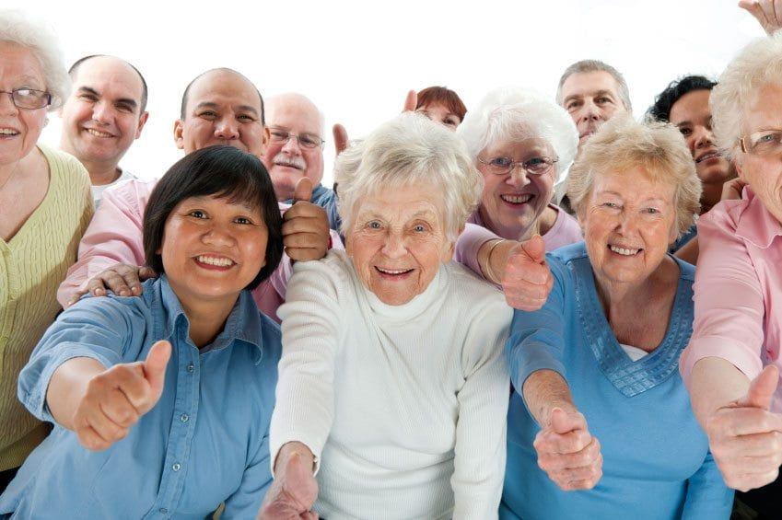
10 TIPS FOR EFFECTIVE COMMUNICATION
Effectively communicating with older adults will be different in each stage.
Alzheimer’s can affect each person differently, assumptions cannot be made about the communication abilities of each individual with the disease.
These tips can help caregivers, friends, and family communicate more effectively with loved ones.
This Photo by Unknown Author is licensed under CC BY-SA-NC
Notes:
10 Tips for Effective Communication
Effectively communicating with older adults will be different in each stage of the disease. Because Alzheimer’s can affect each person differently, assumptions cannot be made about the communication abilities of each individual with the disease.
These tips can help caregivers, friends, and family communicate more effectively with loved ones with dementia as the disease progresses

Slide 12
10 TIPS (cont.)
1. DON’T BE AFRAID TO LAUGH
2. UNDERSTAND THAT NOT ALL COMMUNICATION NEEDS TO BE VERBAL
3. DON’T PULL AWAY
4. AVOID ARGUING, CRITICIZING, OR CORRECTING
5. AVOID OPEN-ENDED QUESTIONS
Notes:
1. DON’T BE AFRAID TO LAUGH
Humor can lighten the mood, reduce stress, and even bring caregiver and patient closer.
2. UNDERSTAND THAT NOT ALL COMMUNICATION NEEDS TO BE VERBAL
Emails, phone calls, and body language are all good ways to show someone you care without requiring an immediate communication response.
3. DON’T PULL AWAY
Your friendship is important to your loved one who is going through a tough time. Being honest about your concerns and feelings can help both of you cope with a difficult diagnosis.
4. AVOID ARGUING, CRITICIZING, OR CORRECTING
Over time, a person with dementia will live in their own reality. Listen and try to understand their main points, but don’t engage in an argument or correct a mistake in speech.
5. AVOID OPEN-ENDED QUESTIONS
Asking simple “yes” or “no” questions will help them make decisions easier and faster, eliminating confusion and disorientation.

Slide 13
10 TIPS (cont.)
6. SPEAK SLOWLY AND CLEARLY, AVOIDING MULTI-STEP INSTRUCTIONS
7. MAINTAIN EYE CONTACT
8. HAVE ONE-ON-ONE CONVERSATIONS IN QUIET PLACES WITH MINIMAL DISTRACTIONS
9. APPROACH THE PERSON WITH DEMENTIA FROM THE FRONT AND INTRODUCE YOURSELF
10. KNOW THAT YOU PLAY AN IMPORTANT ROLE IN YOUR LOVED ONE’S WELL-BEING
Notes:
6. SPEAK SLOWLY AND CLEARLY, AVOIDING MULTI-STEP INSTRUCTIONS
Go through tasks one item at a time, careful not to overwhelm or confuse your loved one.
7. MAINTAIN EYE CONTACT
It’s a simple and easy way to show someone you care about them and are focused on what they are saying.
8. HAVE ONE-ON-ONE CONVERSATIONS IN QUIET PLACES WITH MINIMAL DISTRACTIONS
This will help focus the conversation and be sure your loved one has the opportunity to formulate and ask questions.
9. APPROACH THE PERSON WITH DEMENTIA FROM THE FRONT AND INTRODUCE YOURSELF
Over time, people with dementia will forget faces and names. Being upfront with who you will help put them at ease. Their vision also changes and they lose their peripheral vision over time. It’s important that you always approach them from the front since they wouldn’t be able to see you from the side or behind them.
10. KNOW THAT YOU PLAY AN IMPORTANT ROLE IN YOUR LOVED ONE’S WELL-BEING
Even after your name and face are forgotten, your time, presence, and friendship are important to someone in the late stages of dementia.

Slide 14
Notes:
Thank you so much for participating in this training today.
Please be sure to click the link and complete the very short survey. We really appreciate your feedback
https://www.surveymonkey.com/r/ZB92CJP
If you are interested in additional trainings from the RAFT program, please be sure to visit the RAFT homepage,
RAFTNorthernVirginia.org

Slide 15
References
http://caringforeldery.blogspot.com/2010/04/overcoming-communication-barriers-with.html
- Google,. (2016). 4 Communication Styles. Retrieved from http://1.bp.blogspot.com/-u-R0WLwMCyI/U3mTg9SL8II/AAAAAAAAADE/HGk0_XEekoA/s1600/comm+styles+image.jpg
https://communicationinhealth815.wordpress.com/2-typesstyles-of-communication/
Notes:
Slide 18
Reference page

